Slide 1
Property Tax Rebates & Recoveries PTR & Homestead Benefit
(Federal 1040-Line 21, State Tax Refund Worksheet, &/or Schedule A-Line 6)
TaxPrep4Free.org Website - NJ Special Handling Document
NJ Worksheet F
Notes:
1

Slide 2
NJ Property Tax Relief Programs
Property Tax Deduction/Credit
Homestead Benefit Program
Property Tax Reimbursement (PTR)
AKA Senior Freeze
Other
Deduction for Senior Citizens/Disabled
Deduction for Veterans
Exemption for Disabled Veterans

Slide 3
NJ Property Tax Deduction/Credit
(cont’d)
For: Homeowners, Tenants & Mobile Home Owners
Covered in previous module
NJ taxable income deduction or tax credit, whichever is most beneficial (TaxWise calculates)
Based on real estate tax or rent/mobile home site fees paid
Calculated on NJ Worksheet F; Property Tax Deduction/Credit included on NJ 1040 Lines 38/49
Eligibility:
Age 65 & older OR blind OR disabled
Any Age with Gross income > $20K MFJ (or $10K single or MFS)

Slide 4
NJ Property Tax Deduction/Credit
(cont’d)
To claim Property Tax Deduction/Credit:
For clients that file a NJ Tax Return:
Use Worksheet F on NJ 1040 Page 3
For clients who do not file a NJ Tax Return:
Homeowner – get credit as part of Homestead Benefit
Tenant and Homeowners who are not eligible for Homestead Benefit - Manually complete NJ 1040-H to claim credit

Slide 5
Homestead Benefit Program - Eligibility
Owned & occupied their principal residence in NJ on Oct 1
Home subject to property taxes & taxes paid
Not eligible if exempt from property tax (disabled veteran/spouse) or pay Payments in Lieu of Taxes
NJ Gross Income (NJ 1040 Line 28) must be:
</= $150k for age 65 and over and/or disabled as of 12/31 (not including non-taxable income)
</= $75k for others (not including non-taxable income)
5

Slide 6
Homestead Benefit Program Info
(cont’d)
Apply for benefits each year (in year after taxes paid)
Homestead Benefit application mailed to homeowners in October of year after taxes paid
Apply via phone or web
Deadline: originally November, but frequently extended
Usually will receive credit on property tax bill 2 years after taxes paid. (If NJ budget does not allow, credit may not be paid or pushed back even further)
Credit for 2012 Homestead Benefit was not paid until May 2015 (3 years after taxes paid)
6

Slide 7
Homestead Benefit Program Info
(cont’d)
Tenants
No tenant rebates since 2009
Homeowners
Most people receive Homestead Benefit as a credit applied to their property tax bill. May receive check if:
Lived in a co-op or continuing care facility
No longer owned property that was home on 10/1
Amount calculated by the state
7
Notes:
If homeowner is planning to sell home before application due date, should answer NO to question asking whether you still own the property when filing application
If homeowner sells home after application filed but before credit received, the credit stays with the property. Must handle at closing for sale of home

Slide 8
Property Tax Reimbursement (PTR) - Eligibility
Age 65 or older, or receiving Federal SS Disability Benefits *
Must meet this requirement for two years before first applying. Therefore, must be 66, if applying based on age
Lived in NJ for at least last 10 years continuously as homeowner or tenant *
Owned (leased if mobile home) & lived in home for at least last three years *
Must have paid the full amount of property taxes that were due
Must meet total income limits for appropriate year(s)
* For married couples, only one spouse has to meet age/disability
& residency requirements

Slide 9
PTR Overview
PTR-1 filed first year
Has info for (Current year-2) AND (Current year-1)
Establish “Base Year” amount (Current year–2)
Calculate amount of reimbursement (Current year–1 amount minus Base Year (Current year-2) amount)
PTR-2 filed subsequent years
Has info for (Current year-1) only
Not available online – must use copy mailed to Taxpayer by state with pre-printed info (Name, Base Year amount)
Calculate amount of rebate (Current year-1 amount minus Base Year amount)
Note: If PTR-2 shows not eligible in any subsequent year, must wait 2 years and start over - i.e.-file PTR-1 to establish new (higher) base year
9
Notes:
The application books are Blue, so taxpayers sometimes think of application as “Blue Book”
Applications usually mailed in mid to late February and must be completed by June; deadline frequently extended

Slide 10
PTR Overview Example
Applicant turns 65 in 2014
PTR-1 filed in early 2016 (applicant now at least 66)
PTR-1 probably mailed to TP automatically in early 2016
If not automatic, can request from state or get online
TP fills in eligibility info for both 2014 and 2015 (and gets taxes paid certification for both 2014 and 2015)
Base year established as 2014
Reimbursement amount = (2015 taxes) – (2014 (base year) taxes)
Check received later in 2016
PTR-2 filed in 2017 (and subsequent years)
Pre-printed PTR-2 mailed to TP early 2017
TP fills in eligibility info for 2016 and gets taxes paid certification for 2016
Reimbursement amount = (2016 taxes) – (2014 (base year) taxes)
Check received later in 2017

Slide 11
PTR Overview
(cont’d)
If TP did not apply for PTR when first eligible or missed a year, then TP can file an application for a prior year
Although PTR checks will not be issued for the prior years since filing deadline was missed, this could allow TP to claim a lower base year amount
Refer taxpayer to the PTR hotline for assistance
Details on completing the PTR application covered in separate module
11

Slide 12
NJ Property Tax Relief – Other Administered By Local Municipality
Annual Property Tax Deduction for Senior Citizens, Disabled Persons: Annual deduction of up to $250 from property taxes for homeowners age 65 and older or disabled who meet certain income and residency requirements
Annual Deduction for Veterans: Annual deduction of up to $250 from taxes due on the real or personal property of qualified war veterans and their unmarried surviving spouses/surviving civil union partners/surviving domestic partners
12
Notes:
You can’t apply for vet discount for the first time if spouse is deceased. However, discount continues for surviving spouse if they were already receiving vet discount while spouse was alive

Slide 13
NJ Property Tax Relief – Other Administered By Local Municipality
(cont’d)
Property Tax Exemption for Disabled Veterans: Full exemption from property taxes on a principal residence for certain totally and permanently disabled war veterans and their unmarried surviving spouses/surviving civil union partners/surviving domestic partners. Unmarried surviving spouses/surviving civil union partners/surviving domestic partners of servicepersons who died on wartime active duty may also qualify
13
Notes:
You can’t apply for vet discount for the first time if spouse is deceased. However, discount continues for surviving spouse if they were already receiving vet discount while spouse was alive

Slide 14
NJ Property Tax Relief Programs - Summary
Program | How | Year Received | Possible Recovery
Deduction/Credit | NJ-1040 | Tax Year + 1 | No
Homestead Benefit | Credit on property tax bill | Tax Year + 2/3 * | Yes
PTR / Senior Freeze | Check | Tax Year + 1 | Yes
Other – Senior / Disabled / Veteran | Lower property tax bill | Tax Year | No
* May be delayed due to budget constraints

Slide 15
Property Tax Recoveries – PTR & Homestead Benefit Credit
In current year, NJ homeowners may have received PTR check &/or Homestead Benefit credit/check for prior years’ real estate taxes paid
Can look up PTR & Homestead Benefit amounts online, using links from TaxPrep4Free.org Preparer Page
Determine if these amounts are considered recoveries
Whether PTR is or is not a recovery is independent of whether Homestead Benefit is or is not a recovery (could be one / both / neither)
PTR - If Taxpayer itemized in prior tax year, PTR received in current year is a recovery
Homestead benefit – If Taxpayer itemized on return two/three years prior, Homestead Benefit received in current year is a recovery
If return from 2/3 years ago is not available, assume Homestead Benefit is a recovery unless have other proof that TP did not itemize in that year
Notes:
Taxpayers must claim property tax recoveries in current year if they benefited in prior years by claiming real estate taxes deduction (i.e. – itemized)
Might be able to use TW Summary screen to determine if taxpayer itemized in the past. The Summary screen will be populated with prior years if TW has carry-forward data. However, it only shows 2 prior years. Therefore, it will not be helpful if Homestead Benefit is delayed until the third year after taxes paid
15

Slide 16
Property Tax Recoveries – PTR & Homestead Benefit Credit
(cont’d)
Property tax recoveries must be included on Federal return – there are two possible ways to do so:
Netted against current year real estate tax deduction on Schedule A Line 6 (special dispensation for NJ per IRS letter)
As income on 1040 Line 21 Other Income (standard way described in Pub 17)
Use NJ Property Tax Recoveries Flowchart to determine best method to use (TaxPrep4Free.org NJ Special Handling document, Page 8)
Netting on Schedule A is preferable because TP ends up with lower AGI than using Line 21 approach
Less Social Security may be taxable
Threshold for medical expense deduction is lower
Notes:
16

Slide 17
Sample Cases for Property Tax Recoveries
Taxpayer received a $2,500 PTR & a $1,000 Homestead Benefit in current year and both are recoveries
Scenario 1
Itemizing this year
First try to net recoveries against Sch A real estate taxes deduction
Scenario 2
Not itemizing this year
Must include rebates as income on Line 21
Use NJ Property Tax Recoveries Flowchart in TaxPrep4Free.org NJ Special Handling Document to determine proper way to include recoveries in TaxWise
Notes:
Go through examples on NJ Property Tax Recoveries Flowchart with students
Use scenario of $2,500 PTR and $1,000 Homestead Benefit
17

Slide 18
TW-Property Tax Rebates Claimed on Schedule A Line 6 Box 4 Scratch Pad
Notes:
If Schedule A Line 6 Box 4 is blank, link to a scratch pad and enter the PTR and Homestead Benefit recoveries as negative numbers
If Schedule A Line 6 Box 4 already has a scratch pad that shows real estate taxes on a second property, add PTR and Homestead Benefit recovery amounts to same scratch pad as negative numbers
PTR recovery amount netted on Schedule A may be reduced by using State Tax Refund Worksheet to determine if it is all taxable. Cannot use State Tax Refund for Homestead Benefit recovery, since that is for taxes paid 2/3 years ago. Details for this process can be found in Special Topics document on TaxPrep4Free.org Preparer page. Only experienced counselors should attempt this as it is very complex
18

Slide 19
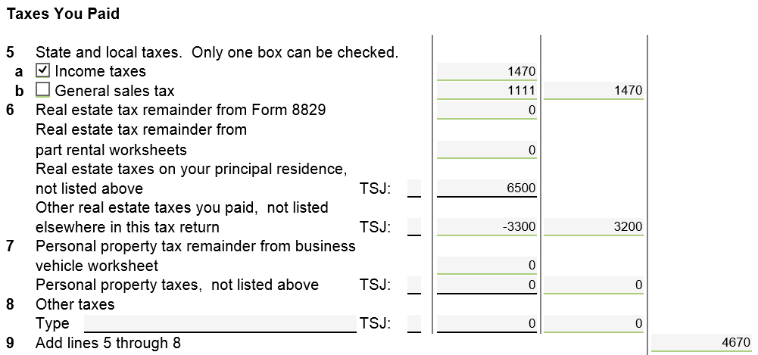
TW-Property Tax Rebates Claimed on Schedule A Line 6 Box 4
Includes tax on 2nd home & PTR/HB recoveries
Line 6 total is still positive
Also check to see if TP is still itemizing
Notes:
If recovery amounts reduce Schedule A Line 6 to a negative amount, remove the recoveries from scratch pad, and delete scratch pad from Forms Tree if now blank
Also, if recovery amount reduces total Schedule A itemized deductions to less than standard deduction, taxpayer would no longer be itemizing. Therefore, remove the scratch pad
Can tell if taxpayer is itemizing when Sch A in Forms Tree is green with a green checkmark. If Sch A is grey, itemized deductions are less than standard deduction, so taxpayer is taking standard
19

Slide 20
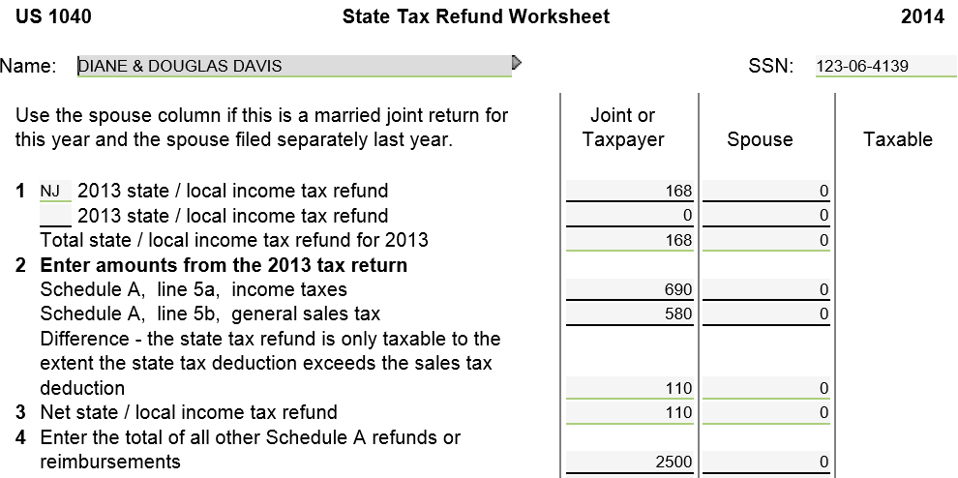
TW-Property Tax Reimbursement (PTR) Recovery Claimed on State Tax Refund Worksheet
PTR recovery
Notes:
Pull up TW State Tax Refund Worksheet screen
Link from Line 10 on 1040 Page 1 (using arrow or F9) OR
Go directly to State Tax Refund Worksheet clicking on St Tax Refund in Forms Tree
Enter amount of PTR received in current year for prior year on Line 4
Could be other recoveries also, such as medical reimbursements. If more than 1 type of recovery, can link to scratch pad to list separately & TW will place total on Line 4
20

Slide 21
TW-Property Tax Reimbursement (PTR) Claimed on State Tax Refund Worksheet
(cont’d)
Taxable amount of income tax refund (to 1040 Line 10)
prior to entry of PTR recovery
Taxable amount of income tax refund (to 1040 Line 10) &
PTR recovery (to 1040 Worksheet 7 & 1040 Line 21)
after entry of recovery – TW apportions maximum taxable
amount
Notes:
Enter appropriate data from prior year’s tax return on State Tax Refund Worksheet Lines 6, 7, 8 & 12 (underlined in red). Applicable lines #s from prior year’s 1040 are given so you know where to get data
Enter # of extra deductions claimed in prior year due to Age 65 or Blind on Line 8 (if appropriate)
Enter taxable income from prior year on Line 15 (underlined in red)
TW will calculate the taxable amount of the recoveries on Line 18 & will transfer that amount to 1040 Wkt 7 & then Line 21 on 1040 Page 1
Total of NJ income tax refunds & NJ property tax refunds are only taxable to the extent that prior year’s Itemized Deductions (Line 6) exceed Total Standard Deductions (Line 13) - $100. TW may change the amount of the income tax refund that was taxable once you enter the data for the property tax recoveries (was $100 taxable before, now only $4 for income tax refund + $96 taxable for property tax refunds = total taxable $100)
If prior year return is not available, enter PTR recovery amount directly on 1040 Worksheet 7 Line 4
21

Slide 22
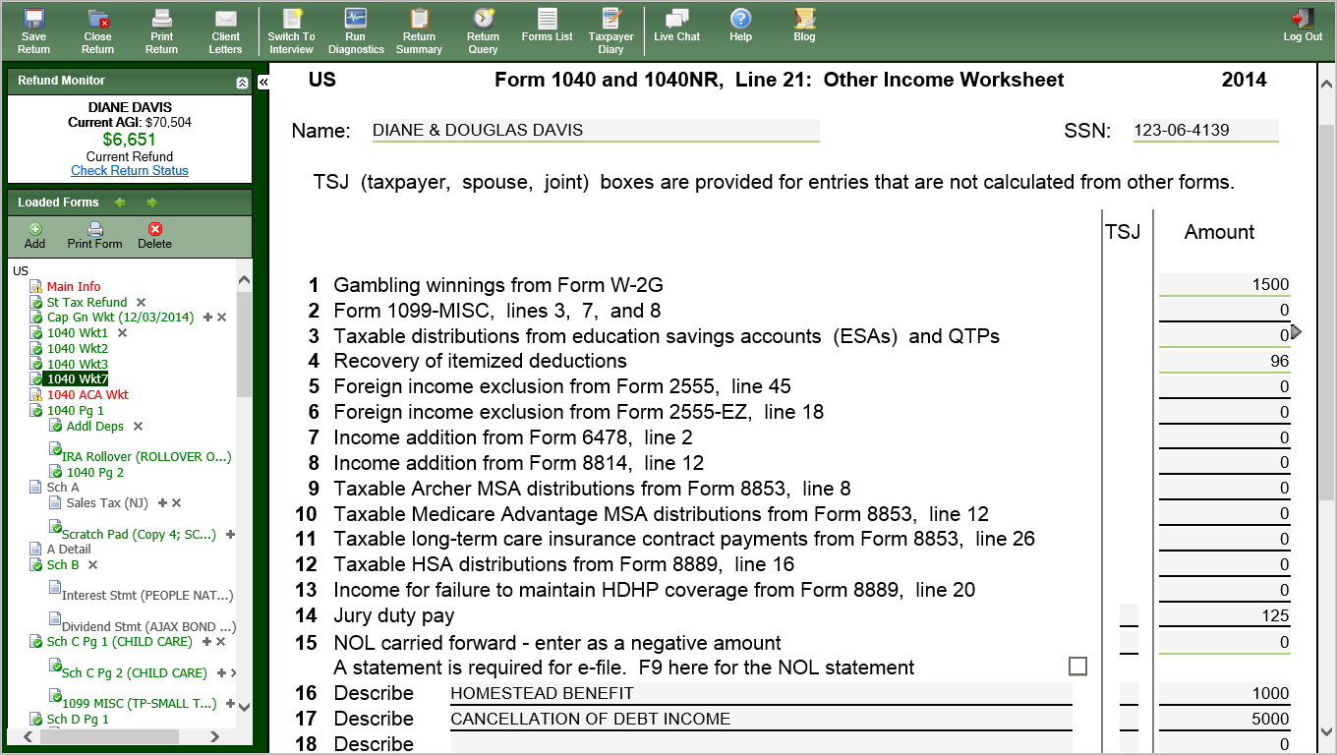
TW - Property Tax Recoveries on 1040 Worksheet 7
(cont’d)
Taxable amount of PTR recovery –
from State Tax Refund Wkt
Homestead Benefit recovery – entered directly on 1040 Worksheet 7
Notes:
If not itemizing, claim Homestead Benefit amount directly on 1040 Line 21 by including on 1040 Wkt 7
22

Slide 23
NJ Adjustment for Property Tax Recoveries on 1040 Line 21
(cont’d)
Property tax recoveries on 1040 Line 21 are not taxable in NJ
Need to exclude recovery amounts from NJ 1040 Line 25 Other Income
Link to NJ Line 25: Supplementary Schedule of Other Income
Enter recoveries as a negative amount in Section F
Any other type of Other Income from Federal 1040 Line 21 should still remain on NJ 1040 Line 25 (e.g. – jury duty pay)
Notes:
23

Slide 24
NJ Line 25: Supplementary Schedule of Other Income
Adjustment is to take PTR and HB
recoveries and Cancellation of Debt income out of NJ taxable income
Notes:
Link to Line 25: Supplementary Schedule of Other Income from NJ1040 Page 2 Line 25 Other Income
Amount on Other Income line is the total of all Other Income from the Federal Line 21 (except for gambling winnings, which go on Line 23 of NJ 1040, not Other Income Line 25)
Enter “ADJ FOR PTR, HB, & COD” on Other line of Box F
Enter total amount of all adjustments with a – sign in front
Cannot use Other income line under Box F because TW does not allow a negative amount on that line
TW will subtract this amount from Other Income on NJ1040 Line 25

Slide 25
Other Income (without PTR & HB Recoveries) - NJ 1040 Line 25
Line 25 might still include other types of Other Income
Notes:
NJ 1040 line 25 is now the amount of Other Income other than PTR, Homestead Benefit and Cancellation of Debt. In this case, the $125 left in Other Income is for Jury Duty Pay

